Slide 1
Monthly Session Report(BCK162)

Slide 2
Introduction
Welcome to the comprehensive recap of Batch BCK162's endeavors throughout the month of March 2024. This encapsulation portrays the enriching odyssey of communication enhancement and personal advancement undertaken by the participants, under the esteemed guidance of Trainer Cibin Sir and Coordinators Sneha and Shibil. Throughout this period, the participants immersed themselves in a diverse array of activities meticulously crafted to refine their communication prowess, cultivate collaborative spirit, and ignite the flames of creativity. From the art of formal letter composition to the collaborative symphony of storytelling, each session was masterfully curated to provide a fertile ground for intellectual growth, skill refinement, and the nurturing of bonds. Join us as we embark on a journey to unveil the highlights, achievements, and profound insights harvested from the vibrant sessions of March 2024.

Slide 3
Gratitude to Trainer
We extend our deepest gratitude to our revered trainer Cibin Sir, for his unwavering dedication, invaluable guidance, and profound expertise that have illuminated our journey throughout the communication sessions. Your steadfast commitment to nurturing our growth and development has left an indelible mark on our hearts and minds. The knowledge and skills you have generously shared with us have empowered us to navigate the realms of effective communication with confidence and grace. Your passion for imparting knowledge and your unwavering support have transformed our learning experience into a truly enriching and unforgettable one. We are immensely grateful to you,Cibin Sir, for being a beacon of inspiration and guidance to us all. Your impact extends far beyond the classroom, shaping us into better communicators and individuals.

Slide 4
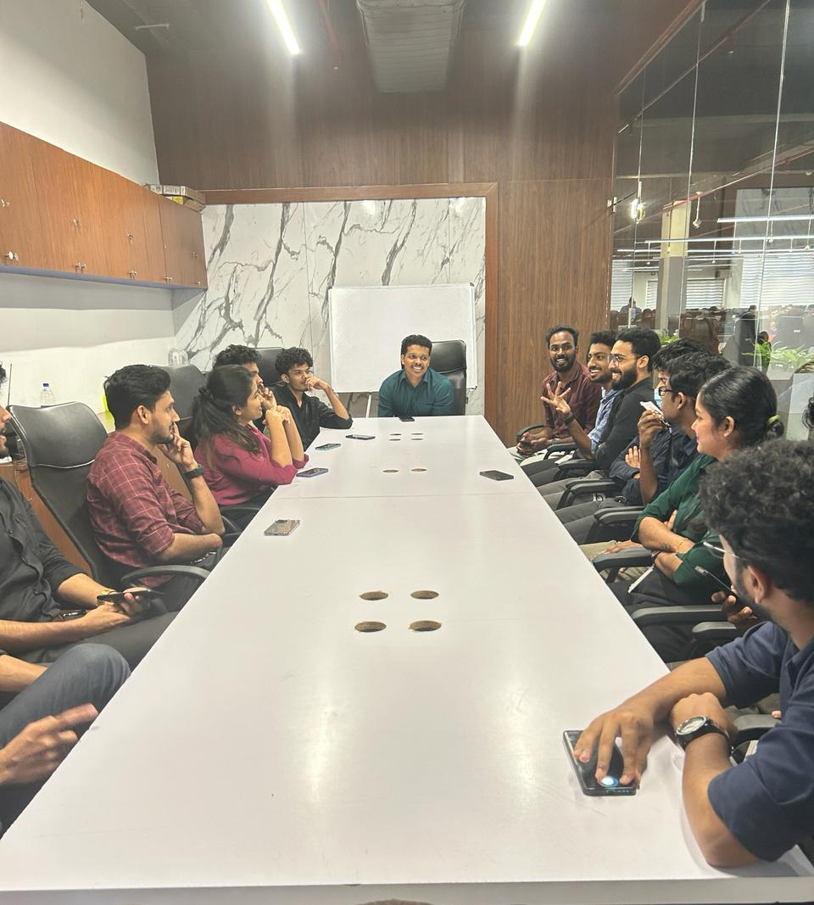
Overview
During March, Batch BCK162 experienced a sequence of stimulating and fruitful communication sessions guided by Trainer Cibin Sir and Coordinators Sneha and Muhammed Shibil, where participants engaged in diverse activities geared towards improving their communication, collaboration, and creativity abilities.

Slide 5
Activity
1st | 2nd | 3rd | 4th | 5th | 6th
Individual speaking | Story Telling | Riddle Challenge | Listening Task | Creative Object Presentation | Role Play

Slide 6
Story Telling:
Engaging in regular storytelling sessions is anticipated to yield numerous advantages for participants, encompassing heightened storytelling abilities, bolstered self-assurance, fortified group cohesion, ongoing learning prospects, sharpened narrative construction skills, and nurtured empathy.
Listening Task:
The daily listening tasks are anticipated to offer numerous advantages for participants, encompassing refined listenin skills, heightened attentiveness, improved comprehension, strengthened interpersonal connections, ongoing educational opportunities, enhanced critical thinking capabilities, and nurtured empathy.
Story Telling:
Participating in regular storytelling sessions is anticipated to offer numerous advantages for individuals, such as honing storytelling abilities, bolstering self-assurance, fostering cohesive group dynamics, facilitating ongoing learning experiences, refining problem-solving skills, and nurturing empathy.
01
02
03

Slide 7
Conclusion
In conclusion, the monthly sessions have been absolutely essential in cultivating an atmosphere of growth, cooperation, and empowerment among all participants. Through a diverse array of engaging activities and stimulating discussions, attendees have explored various aspects of communication, cultural appreciation, and personal growth. Events like the observance of International Women's Day, reflecting our dedication to diversity and advocacy for gender equality, highlight the inclusivity and significance of our sessions. Additionally, the integration of structured daily tasks and timeline-based activities has offered a clear path for honing skills and continuous improvement. Looking ahead, these sessions will remain a source of inspiration and catalyst for personal and professional advancement, equipping participants with the necessary tools and confidence to excel in their communication pursuits and beyond.

